Slide 1
ACU 2024 Benefits Open Enrollment

Slide 2
Objectives
Provide a well-rounded, competitive benefits offering to employees
Provide affordable benefits to employees
Benefit cost as compared to total compensation = 30%
Target of 70/30 cost share split between ACU and employees for medical

Slide 3
2024 Benefits Enrollment Key Points
Open Enrollment is November 6 – November 10
Enroll in Selerix (same myACU login and process as last year, but new enrollment system)
Everyone must complete enrollment
If enrollment is not completed you will be disenrolled and will have to wait until 1/1/25 to enroll, unless you experience a qualifying event

Slide 4
What’s Changing for 2024?
We are proud to announce:
Medical administrator transitioning to HealthComp & HST (replacing Imagine360 & ELAP)
NO NETWORK CHANGE!
Employee & Employee/Child premiums staying the same; slight increase to Employee/Spouse & Employee/Family
Telemedicine vendor changing to Teladoc
No changes to True Rx or SHARx pharmacy programs
Dental, Vision, Life, Disability & Worksite transitioning to The Standard
New dental network, but anticipate enhanced network presence
Vision network staying the same through VSP
Dental and vision premiums decreasing!
New Hospital Indemnity plan
Employee Enrollment Support available to all employees through Avant
Regenexx, an alternative to orthopedic/musculoskeletal procedures, will be available through the medical plan

Slide 5
Dental Plan The Standard
Plan Feature | Dental Plan
Annual Deductible | $50 Individual / $150 Family
Annual Benefit Maximum | $1,500
Type I – Preventive Services Oral exams, x-rays, routine cleanings (once every 6 months) | Covered at 100% (no deductible)
Type II – Basic Services Fillings, extractions, root canals, periodontal surgery | Covered at 80% after deductible
Type III – Major Services Crowns, roots, dentures, veneers | Covered at 50% after deductible
Type IV – Orthodontia (Child and Adult coverage) | 50% up to $1,000 lifetime maximum
Out-of-Network Reimbursement | 90th Percentile
Dental Bi-Weekly Premiums
Employee Only | Employee + Spouse | Employee + Child(ren) | Family
$19.74 | $40.05 | $37.94 | $57.92
NEW! MaxBuilder program allows $150 of your dental annual maximum to be used towards vision expenses
New dental network through Ameritas

Slide 6
Vision Plan The Standard
Plan Feature | Vision Plan
Eye Exam (once every 12 months) Contact Lens Fitting Fee | $20 Copay Up to $60
Lenses (once every 12 months) | $20 Copay
Frames (once every 24 months) | Up to $150 allowance + 20% discount on remaining balance
Contact Lenses (once every 12 months, in lieu of glasses) | Up to $150 allowance
Vision Bi-Weekly Premiums
Employee Only | Employee + Spouse | Employee + 1 Child | Employee + Children (2+) | Employee + Family
$3.60 | $5.22 | $5.22 | $9.35 | $9.35
NEW! MaxBuilder program allows $150 of your dental annual maximum to be used towards vision expenses
Same VSP Choice Plus network

Slide 7
Life and AD&D The Standard
ACU provides Basic Life/AD&D to all eligible employees
1x annual base earnings up to $300,000*
Voluntary Life/AD&D*
Evidence of Insurability (EOI)
- THIS YEAR ONLY! If you are enrolled today, you and your spouse can increase your election up to GI with no EOI; OR if you are not enrolled today, you can elect up to the GI amount with no EOI
- If you are enrolled today, but enrolled over the GI, any increases are subject to EOI
IMPORTANT: Update your beneficiary in Selerix
*Benefit reduced to 65% for employees aged 65-69 and 50% for employees aged 70 or older
Type of Coverage | Increments | Maximum Benefit | Guarantee Issue
Employee | $10,000 | $500,000 | $200,000
Spouse | $5,000 | 100% of employee election up to $250,000 | $50,000
Child(ren) | $1,000 | $10,000 | Child elections are always Guarantee Issue (no EOI ever required)
True OE this year!

Slide 8
Short-Term and Long-Term Disability The Standard
Voluntary Short-Term Disability
STD benefit up to 60% of weekly earnings, max $1,750/week
7 day waiting period for injury and sickness
If late enrollee, you will have a 60 day waiting period for any sickness or pregnancy
Cannot use sick leave & STD at the same time
Long-Term Disability
Paid for by ACU for all eligible employees
LTD benefit up to 60% of monthly earnings, max $15,000/month
Enhanced benefit!

Slide 9
Voluntary Worksite Coverages The Standard
Accident
Covers wide range of injuries and accident-related expenses
Examples (not all inclusive): ER/urgent care visits, x-rays, dislocations/fractures, surgeries, lacerations/burns, and more
Includes $100 wellness benefit for receiving an annual exam (don’t forget to file for your 2023 reimbursement if you are currently enrolled in the accident plan and had your annual physical from 1/1/23-current)
Critical Illness
Provides lump-sum cash benefit at occurrence of major critical illnesses
Examples (not all inclusive): cancer, heart attack, stroke, Alzheimer’s, Parkinson’s, and more
Includes $50 wellness benefit for receiving an annual exam (don’t forget to file for your 2023 reimbursement if you are currently enrolled in the plan and had your annual physical from 1/1/23-current)
NEW! Hospital Indemnity
Provides lump-sum cash benefit at time of hospitalization/ICU stay
NEW PLAN!

Slide 10
Medical & Pharmacy Plan Design High Deductible Health Plan (HDHP) & PPO with HealthComp/HST
All new ID cards for 2024 due to a new carrier
Plan Feature | HSA HDHP (In-Network) | PPO (In-Network)
Deductible | $3,500 Individual / $7,000 Family | $1,500 Individual / $3,000 Family
Coinsurance | 100% (In-Network Only) | 70% (In-Network Only)
Out-of-Pocket Maximum | $3,500 Individual / $7,000 Family | $3,500 Individual / $7,000 Family
Physician Office Visit | Covered at 100% after deductible | $30 Copay PCP & $60 Copay Specialist
Preventive Care | Covered at 100%, no deductible | Covered at 100%, no deductible, no copays
Labs, X-Rays & Diagnostic Imaging | Covered at 100% after deductible | Covered at 70% after deductible
Urgent Care / Emergency Room | Covered at 100% after deductible | $100 Copay UR & $200 Copay ER
Inpatient / Outpatient Hospital Services | Covered at 100% after deductible | Covered at 70% after deductible
Rx Plan Feature | HDHP (In-Network)* | PPO (In-Network)*
Tier I | Covered at 100% after deductible | $5 Copay
Tier II |  | $50 Copay
Tier III |  | $75 Copay
Specialty |  | $100 Copay
Mail Order Program (90 day supply) | Covered at 100% after deductible | 2.5x Copay
* Cost sharing in place for all prescriptions under $350/month; See SHARx info for all prescriptions over $350/month

Slide 11
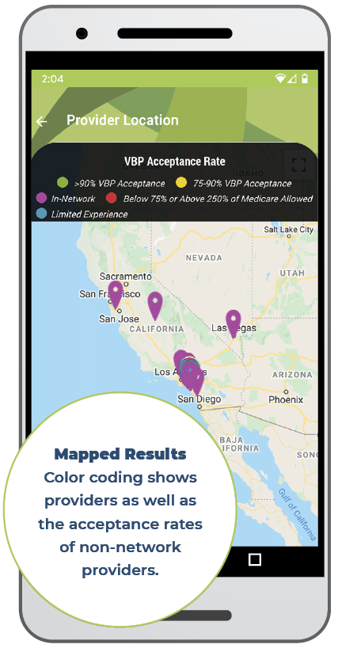
Medical Plan, cont.
Teladoc is new telemedicine vendor for employees & dependents enrolled in medical plan
Cost Plus Method for Facilities
Physician and Rx not impacted
All inpatient and outpatient FACILITY claims are audited applying the Cost Plus Method
Certain medical procedures and services will be paid at cost plus basis (bottom-up) rather than a percentage off retail prices (top-down)
HST Support
Patient Advocacy Center (PAC): HST’s customer service experts
Balance Bills: You must notify PAC of ANY Balance Bill for Facilities
The HST app allows you to see RBP provider acceptance rates, provider quality metrics, see cost estimates prior to receiving services, and more
Notes:
RxBenefits

Slide 12
Pharmacy Plan Details
Prescriptions under $350/month Vendor: True Rx Changes To Be Aware Of: New ID card through HealthComp No other changes! | Prescriptions over $350/month Vendor: SHARx (works w/ True Rx behind the scenes to provide low cost medications for YOU!) Changes To Be Aware Of: All employees taking a medication over $350/month today will need to complete an online SHARx enrollment survey to take advantage of cost savings at first fill next year SHARx fills prescriptions through multiple channels: Manufacturer coupons (avg. cost to member $5-$25 per month) Foundation funds ($0 cost to member) Borders ($0 cost to member) If you choose not to participate in the SHARx program, you will receive 2 fills through the ACU plan subject to normal plan components, then your 3rd fill+ will be denied

Slide 13
2024 Medical Plan Premiums
2024 Premium Structure
All employees will have the same base premium in 2024
If you (and your spouse, if enrolled) did not complete all of your wellness requirements by 9/30/23, you will not receive the full wellness discount for 2024
MONTHLY | HDHP (Full Wellness Discount Applied) | PPO (Full Wellness Discount Applied)
Employee Only | $100 (no increase!) | $200 (no increase!)
Employee + Spouse | $404 (increase of $14/month) | $540 (increase of $20/month)
Employee + Child(ren) | $270 (no increase!) | $400 (no increase!)
Employee + Family | $600 (increase of $14/month) | $737 (increase of $21/month)
The wellness charge remains $50/month per employee. PLUS $50/month per spouse (add to the base rates listed above)
The Selerix enrollment system will be updated with wellness completion activity through September. Please verify your deductions on your first pay stub in 2024. If you did not receive the correct wellness discount, you can contact ACU HR or Elsa Dunson to verify completion of all requirements

Slide 14
NEW! Regenexx
Member Testimonials:
“By using Regenexx I was able to avoid having surgery on both of my knees”
“I didn’t want to have a traditional surgical procedure where they would have to cut on my knee. I was only off of work for four days with the Regenexx procedure”
“I could not have afforded traditional surgery, and with Regenexx I was only out of work for two days”
Regenexx provides a choice in treatment for musculoskeletal & orthopedic injuries – eliminating the need for up to 70% of orthopedic surgeries! (no surgery, less follow-up care/physical therapy needed & reduced recovery time, less pain medication needed, etc)
Most procedures are same-day, outpatient services (closest location to Abilene is in Fort Worth; Regenexx has locations around the US)
Regenexx uses your own body’s stem cells as natural healing agents to treat damaged bone, cartilage, muscle, tendon, ligament issues & more
Will be covered as in-network benefit (subject to deductible & coinsurance on all plans)
Contact Regenexx at 866-535-4123 or regenexxbenefits.com/acu to learn more

Slide 15
Wellness Program
New Deadline – July 31, 2024
Anyone that completed requirements in August – September 2023 will be given credit for this one time change
Employee Requirements:
Must complete by 7/31/24 to earn full premium incentive in 2025
Annual preventive exam AND biometric screening
Recommend getting age/gender appropriate exams as applicable (will likely be required in the future, so get in the habit now)
Spouse Requirements:
SAME AS EMPLOYEE

Slide 16
Health Savings Account (HSA)
Only available to employees enrolled in the HDHP
Employee-owned medical savings account
No “use it or lose it” rule
Who is eligible to have an HSA?
Must be enrolled in HDHP and not enrolled in Medicare or another health plan
Spouse can not be enrolled in an FSA
You can use HSA funds for yourself and your household dependents

Slide 17
Health Savings Account (HSA)
HSA Bank is our HSA vendor
No new debit card for employees already enrolled in the HSA plan
Pre-tax dollars to pay for qualified medical expenses
Prescriptions, dental & vision expenses, doctor’s visits, non-cosmetic surgeries, physical therapy, hearing aids, etc.
Contributions can be from both ACU and you
Employees 55+ may contribute an additional $1,000 per year
 | 2024 IRS Cal. Year Contribution Limit | 2024 ACU HSA Cal. Year Contribution | 2024 Cal. Year Maximum Employee Contribution
Employee Only | $4,150 (increased by $300) | $500 | $3,650
Employee + Spouse | $8,300 (increased by $550) | $1,000 | $7,300
Employee + Child |  | $1,000
Family |  | $1,000

Slide 18
Flexible Spending Accounts (FSA)
Health Care FSA (only if enrolled in the PPO)
Dependent Care FSA (DAYCARE - available to both HDHP & PPO participants)
What is an FSA?
Employer owned medical spending account
“Use it or lose it” rule applies
You contribute pre-tax dollars to pay for qualified medical (or childcare) expenses
IRS Annual Contribution Limits
 | 2024 IRS Contribution Limit
Health Care FSA | $3,050
Dependent Care FSA | $5,000

Slide 19
Other Benefits
Retirement – No Changes!
ACU Tuition Discount
Dependent children of full and reduced full-time 100%
Dependent benefit only for undergraduate degree
Employees taking classes have a 6 month waiting period
ID Theft Assistance (AIG – provided by ACU)
Employee Assistance Program (The Standard)
24/7 telephonic assistance plus 3 FREE face to face visits per household member
Travel Assistance (The Standard)

Slide 20
Leave Benefits
Sick-to-Service Hours Benefit Program
Employees can convert up to 40 hours of sick leave for approved S2S hours each calendar year if balance met
Parental Leave
6 weeks of parental leave for birth or adoption
Applies to both mother & father
If both mother & father are ACU employees, both are eligible for parental leave
Personal Days
Employees will have additional 2 days per year
Will not rollover from year to year

Slide 21
ACU On-Campus Medical Clinic
Accessible to all ACU employees & dependents - $45 office visit fee
Annual physical exam at no cost to those covered by ACU’s medical plan (required for the wellness discount if covered on medical plan)
Flu/cold symptoms, flu shots, acute symptoms, etc
Clinic will send your prescription to your preferred pharmacy
NOTE: Clinic does not file visits with any medical insurance

Slide 22
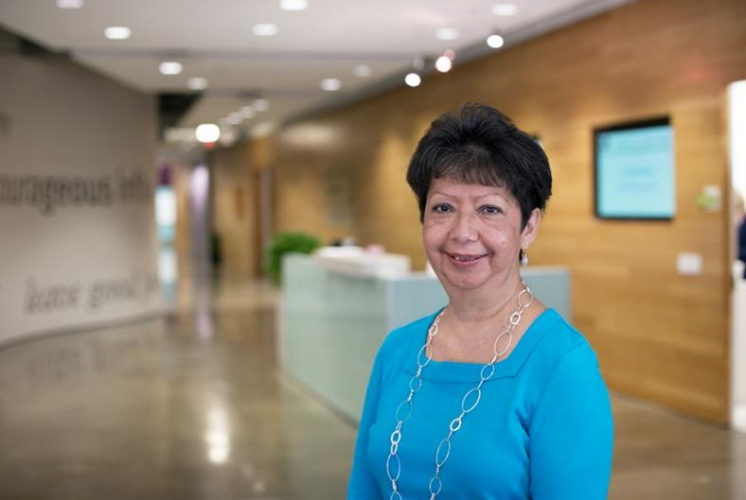
Your Holmes Murphy Benefits Analyst
Elsa Dunson
edunson@holmesmurphy.com
972-663-7304
When am I eligible to enroll in benefits?
I’ve lost my ID card, how do I get a new one?
What is my deductible and what does “co-insurance” mean?
I received a bill from my doctor – was my claim paid correctly?

Slide 23
Questions for our vendors or Elsa Dunson?
We will be in the top floor of the library on Mon-Thur of OE week (11/6-11/9); Elsa will be in person on Monday 11/6
Virtual appointments available by request and for Dallas employees
The Avant Enrollment Support team can assist all employees

Slide 24
How to Enroll for 2024
Open Enrollment dates: November 6 – November 10
Log on to myACU and select “Benefits Enrollment” under Quicklinks
In person, phone and virtual appointment options
2024 Benefits Enrollment Guide to be delivered via email in the coming days

Slide 25
2024 Benefits Enrollment Reminders
Imagine360/ELAP is transitioning to HealthComp; new ID cards for all enrollees
Promptly notify PAC of any balance bills
Utilize the HST app to see provider acceptance & quality rankings
If you receive an outreach from SHARx, you must enroll
Dental, Life and Disability, and Vision are changing to The Standard; new dental network
Utilize your benefits analyst (Elsa) to ensure you are using your benefits in the best way possible
Urgent Care vs ER, ACU Clinic & Teladoc Telemedicine
Avant Enrollment Support available to all employees

Slide 26
THANK YOU!
If you have any questions, please reach out to:
- Elsa Dunson (edunson@holmesmurphy.com)
- HR (humanresources@acu.edu)
- Avant (866 318-0080)

